Slide 1
PISA 2015
Excellence and Equity
in Education
Peter Adams
Senior Manager, PISA

Slide 2
Russia’s participation in PISA
OECD very pleased to participate in the Federation's launch of the 2015 PISA results
Provide background to PISA and make high-level observations of Russia’s performance
In every PISA cycle since 2000
A commitment to international benchmarking
Objectively assessing performance and what drives improvement
Supporting evidence-based policy making

Slide 3
What is PISA? (Focus and Key Issues)
International assessment conducted every 3 years
Looking at school systems in 72 countries and economies (2015)
Students assessed in science, mathematics, reading, and collaborative problem-solving
Key issues:
How far are we nurturing a generation of scientifically literate young people?
Are schools adequately preparing young people for adult life?
What kinds of learning environments do we find in high performing systems?
Can schools improve the futures of students from disadvantaged backgrounds?

Slide 4
What is PISA? (Content and Outputs)
An internationally agreed 2-hour test…
Goes beyond testing whether students can reproduce what they were taught…
… to assess students’ capacity to use what they know and creatively apply
their knowledge in novel situations
Science, mathematics, reading and collaborative problem-solving
Total of 390 minutes of assessment material
Students responded to questions on…
their personal background, their schools, their well-being and their motivation
Parents, principals, teachers and system leaders provided data on …
school policies, practices, resources and institutional factors that help explain performance differences

Slide 5
PISA 2015
OECD
Partners

Slide 6
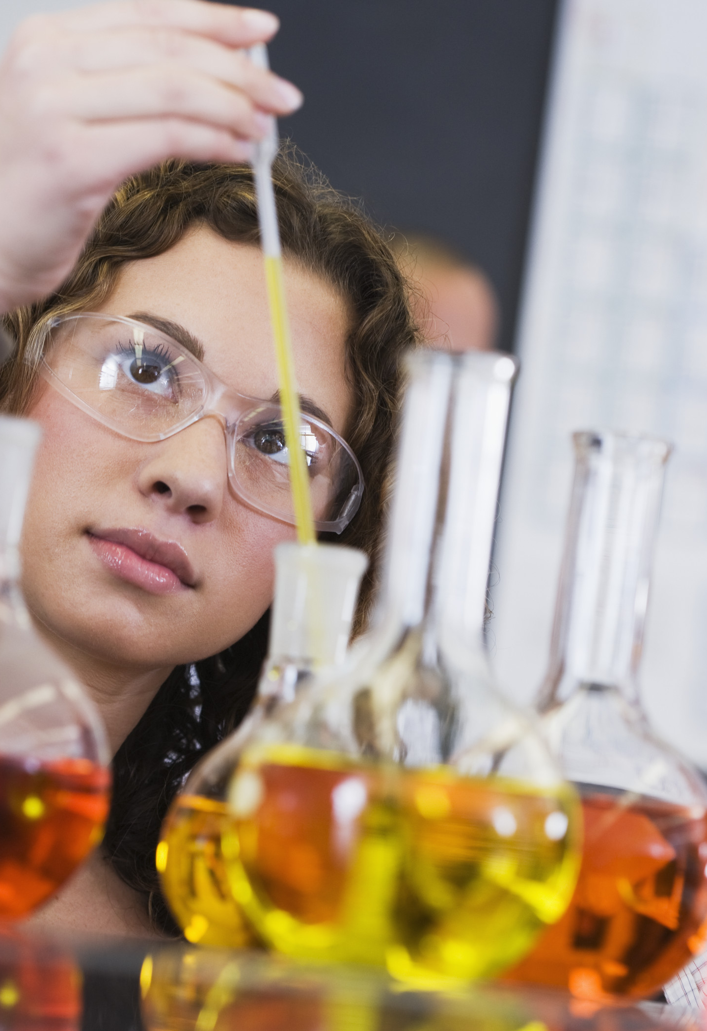
Science in PISA
“the ability to engage with science-related issues, and with the ideas of science, as a reflective citizen”
A scientifically literate person is willing to engage in reasoned discourse about science and technology

Slide 7
Performance in and attitudes towards science
Think like a scientist!
Context
Personal, local, global
Current and historical
Competencies
Explain phenomena scientifically
Evaluate and design scientific enquiry
Interpret data and evidence scientifically
Knowledge
Content
Methodological procedures
Epistemic reasons and ideas
Attitudes
Attitudes to science
Scientific attitudes

Slide 8
Mean score
Figure I.2.14
Mean science performance
SNAPSHOT - Russia’s performance in science
2015 RF mean score = 487
[OECD average = 493]
OECD:
2006 – 2015 av. gain = +5
Russian Federation:
2006 mean score = 479
2006 – 2015 gain = +8
Decrease low perform. students = 4%
High performing = no sig. change
Gender: boys = marginally higher than girls in top performers
[High performing countries??]
10 countries perform below this line…

Slide 9
https://www.oecd.org/pisa/test/

Slide 10
What about Mathematics and Reading?
Mathematics (mean performance in PISA)
2003 - 468
2006 - 476
2009 - 468
2012 - 482
2015 - 494
Change 2012 – 2015 = 11.9
Reading (mean performance in PISA)
2009 - 459
2012 - 475
2015 - 495
Change 2012 – 2015 = 19.5

Slide 11
Thank you
How PISA works
FAQs
PISA 2015 Assessment and Analytic Framework
PISA in Focus: No.66 [Assessing science literacy]
Take the Test – Examples of Test Items
PISA Education GPS
PISA Data Explorer
Research Documentation
PISA Database
Publications
OECD PISA www.oecd.org/pisa

Slide 12
PISA 2015
Excellence and Equity
in Education
Peter Adams
Senior Manager, PISA

